Slide 1

YEREVAN STATE UNIVERSITY OF ARCHITECTURE AND CONSTRUCTION
Economics, Law and Management Chair
(Introduction)
Presented by Dr. Irina Gh.Vanyan,
Armenia - June 11, 2012

Slide 2
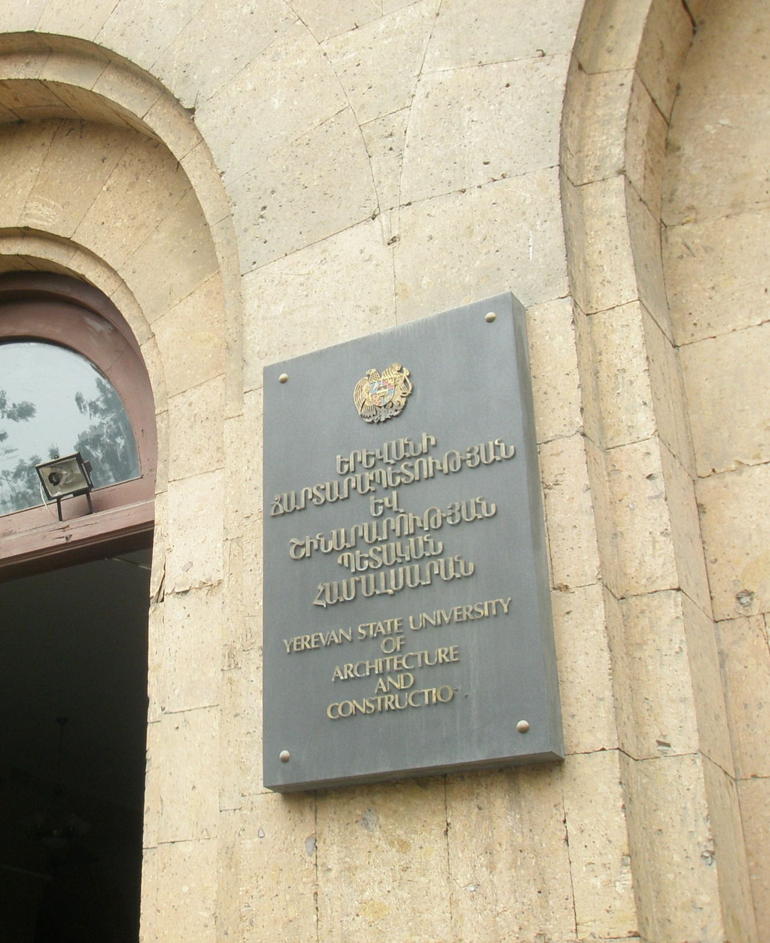
YEREVAN STATE UNIVERSITY OF ARCHITECTURE AND CONSTRUCTION
BRIEF INTRODUCTION
History
Management
Structure
Staff
Specialties

Slide 3
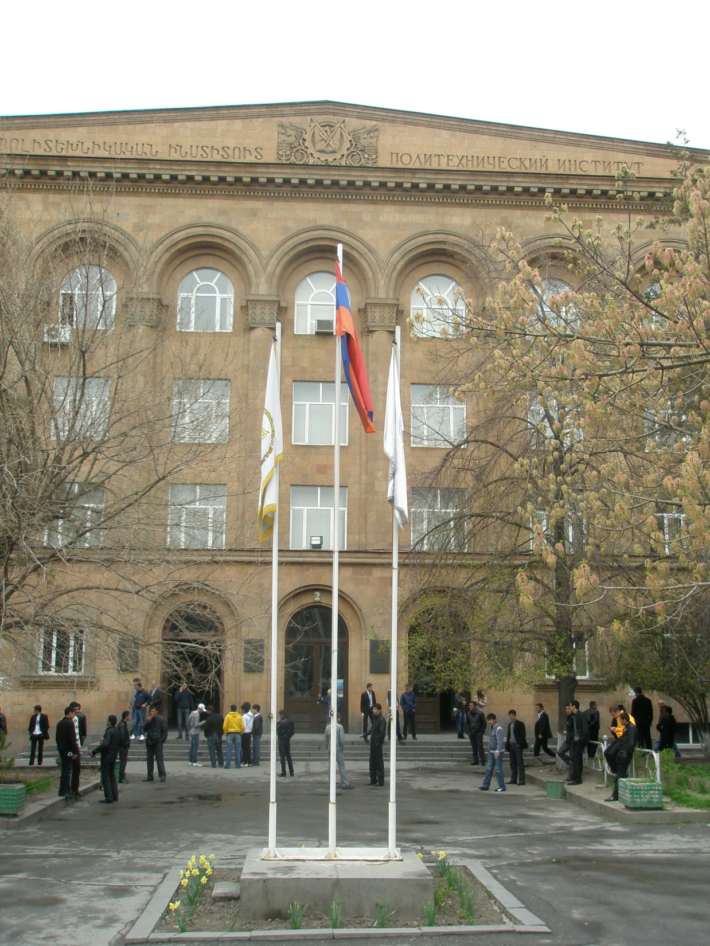
YEREVAN STATE UNIVERSITY OF ARCHITECTURE AND CONSTRUCTION
HISTORY
1930 – the first Construction Institute was established based on technical faculty of the State University of Armenia.
1933 - Construction Institute was transferred to Polytechnic Institute of Yerevan named by K.Marks.
1955 - the central corpus of Polytechnic Institute of Yerevan was built.

Slide 4
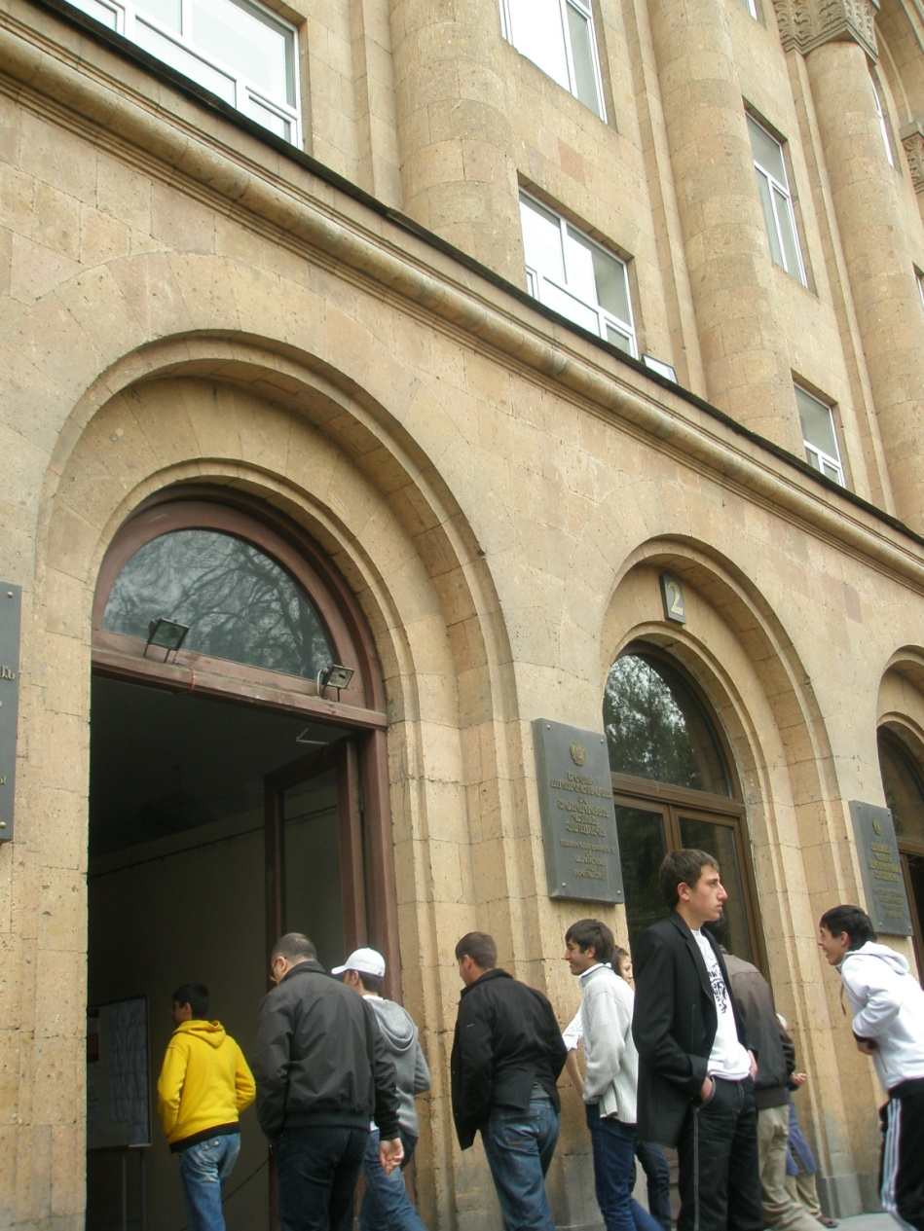
YEREVAN STATE UNIVERSITY OF ARCHITECTURE AND CONSTRUCTION
HISTORY
1989 - Architecture and Construction Institute was developed based on appropriate faculties and chairs of the Polytechnic Institute.
2000 - Architecture and Construction Institute was re-named to Yerevan State University of Architecture and Construction.

Slide 5






YEREVAN STATE UNIVERSITY OF ARCHITECTURE AND CONSTRUCTION
ORGANIZATIONAL STRUCTURE
Council of University – 32 members
Rector
(Head of Council)
Staff of Rector
Departments - 6
Faculties - 9
Chairs - 26

Slide 6
YEREVAN STATE UNIVERSITY OF ARCHITECTURE AND CONSTRUCTION
Organizational Chart of Educational Unit
1 Faculties
3 Chairs
Architectural
Computer Design
2 Faculties
3 Chairs
DEPARTMENTS - 6
Management & Technology
3 Faculties
5 Chairs
Construction
3 Faculties
10 Chairs
External
Post-graduate Professional Education

Slide 7
YEREVAN STATE UNIVERSITY OF ARCHITECTURE AND CONSTRUCTION
STUDENTS
1971
Present Students
244
External Students
577
Foreign Students
TOTAL NUMBER
2792

Slide 8
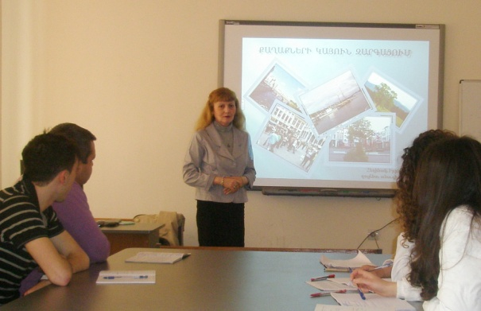
YEREVAN STATE UNIVERSITY OF ARCHITECTURE AND CONSTRUCTION
Academic Staff of the YSUAC
LECTURERS - 391
Full time
263 (67%)
Part time
128 (33%)
PhD
145 (55%)
Assistants & Lecturers
118 (45%)
PhD
58 (45.5%)
Assistants & Lecturers
70 (54.5%)

Slide 9
YEREVAN STATE UNIVERSITY OF ARCHITECTURE AND CONSTRUCTION
Departments of Management & Technology
Faculty of Computers & Management
Faculty of Economics
Faculty of Cadastre & Ecology
1C
CHAIRS
4C
2C
3C
ELM

Slide 10

YEREVAN STATE UNIVERSITY OF ARCHITECTURE AND CONSTRUCTION
The Economy, Law and Management Chair (“ELM")
GOAL of activity:
to organize the high education process with modern economics and management knowledge promotion in:
real estate,
urban economics,
construction,
natural resource using.

Slide 11

YEREVAN STATE UNIVERSITY OF ARCHITECTURE AND CONSTRUCTION
The Economy, Law and Management Chair (“ELM")
Academic Staff of “ELM”
includes more than 40 lecturers,
has a professional staff
up to 35% has scientific degrees and titles.

Slide 12

YEREVAN STATE UNIVERSITY OF ARCHITECTURE AND CONSTRUCTION
The Economy, Law and Management Chair (“ELM")
produce the bachelors and masters for the following specialties:
080600(1) Enterprise economics and management (in construction field)
080600(2) Enterprise economics and management (in urban, housing and communal services)
081000 Natural resources using
271200 Real Estate expertise and management
081500 Accounting (in construction field)

Slide 13

YEREVAN STATE UNIVERSITY OF ARCHITECTURE AND CONSTRUCTION
The Economy, Law and Management Chair (“ELM")
Bologna reforms in higher education
engaged in the process of Bologna reforms, jointly with the YSUAC, since 2006,
adopted two level (Bachelor and Master) of education system,
adopted assessment credit system with purpose to be integrated into European higher education area.

Slide 14
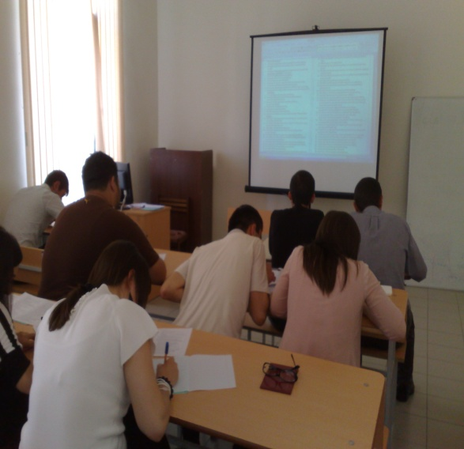
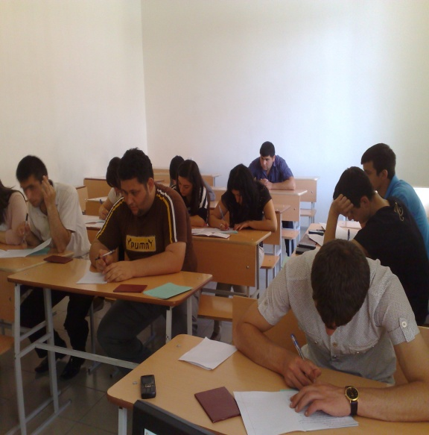
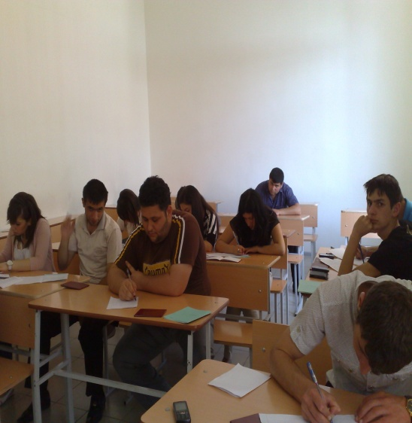
YEREVAN STATE UNIVERSITY OF ARCHITECTURE AND CONSTRUCTION
STUDY DURATION
Bachelors: 4 Years
Masters: 2 Years

Slide 15
YEREVAN STATE UNIVERSITY OF ARCHITECTURE AND CONSTRUCTION
The Economy, Law and Management Chair (“ELM")
International Programs
Geographic information technology for sustainable
development in Eastern neighboring countries/ Royal Institute of Technology (KTH), Sweden/ 511322-TEMPUS-1-2010-SE-JPCR
Higher Education System Development for Social Partnership Improvement and Humanity Sciences Competitiveness/ Information Systems Management Institute (ISMA), Latvia/ 159338-TEMPUS-1-2009-1-LV-TEMPUS-SMHES (January 2010 – January 2013)

Slide 16
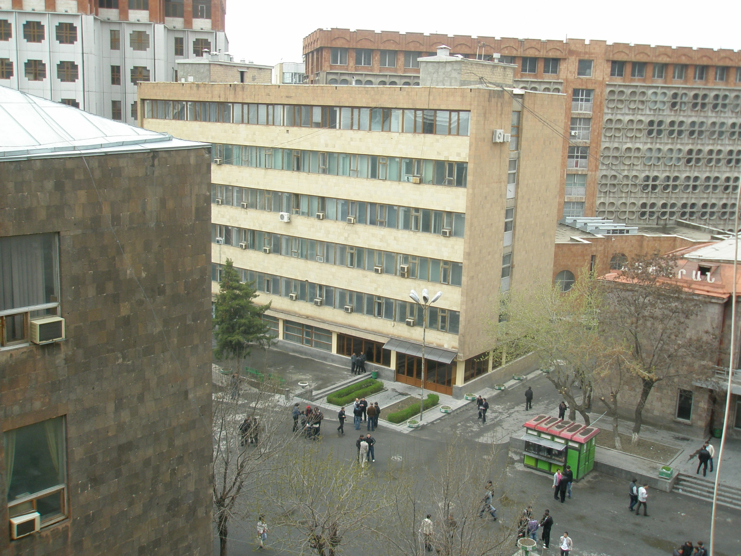
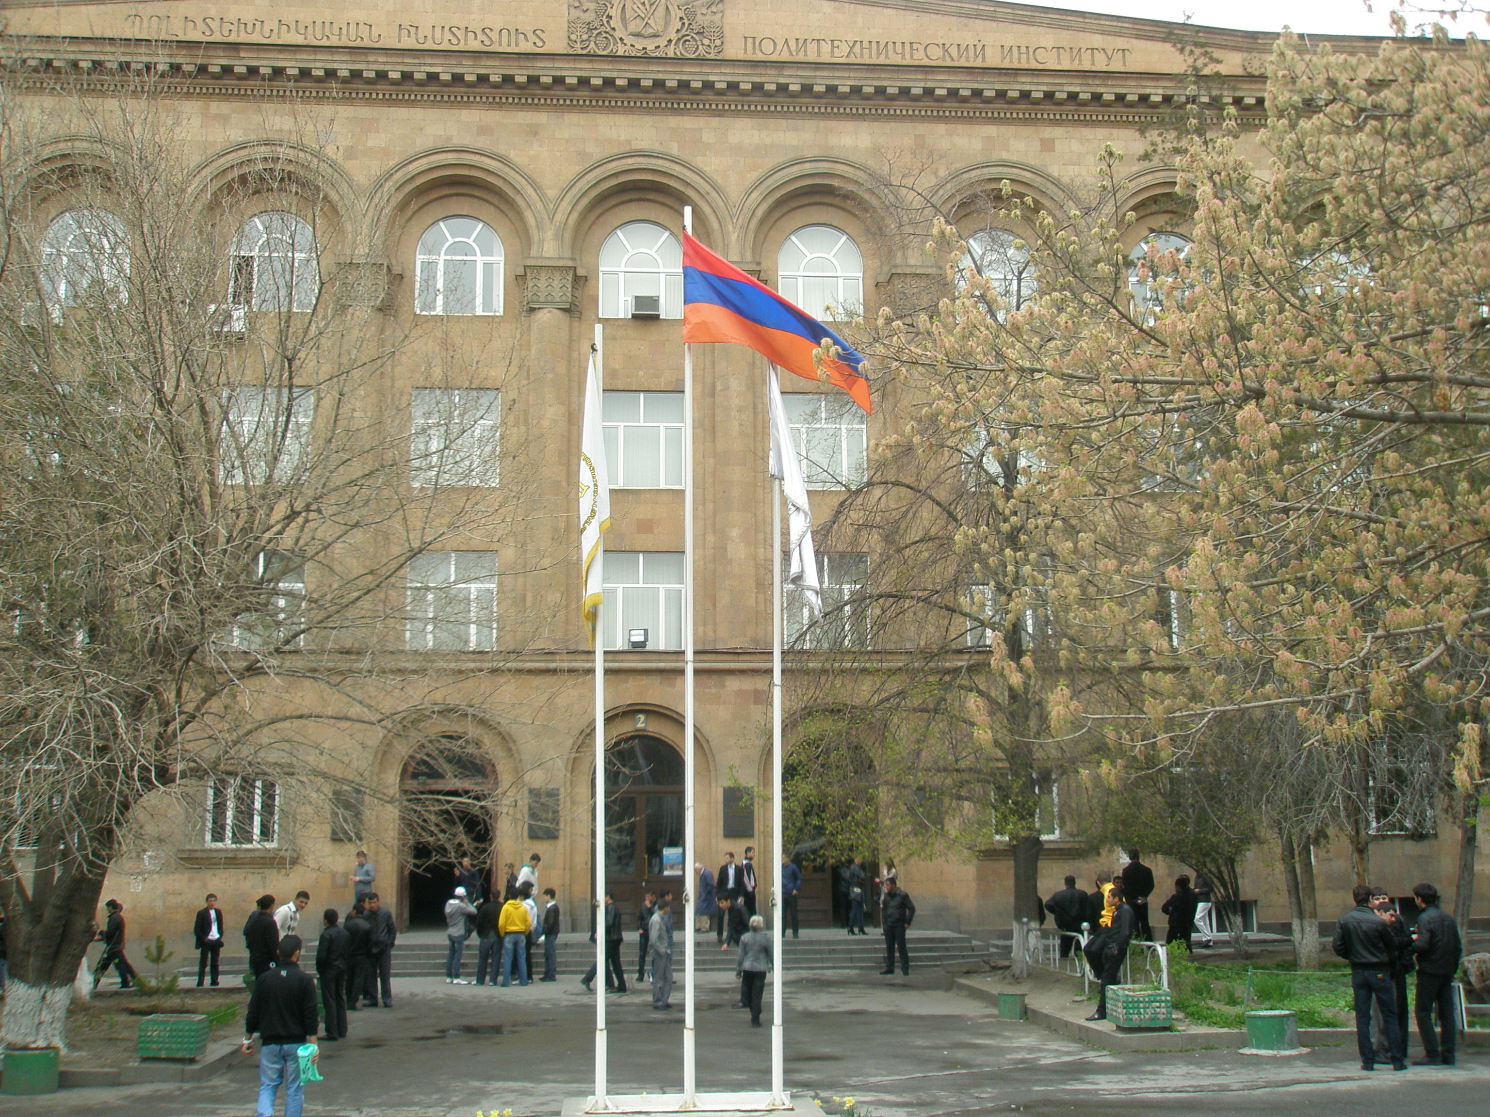
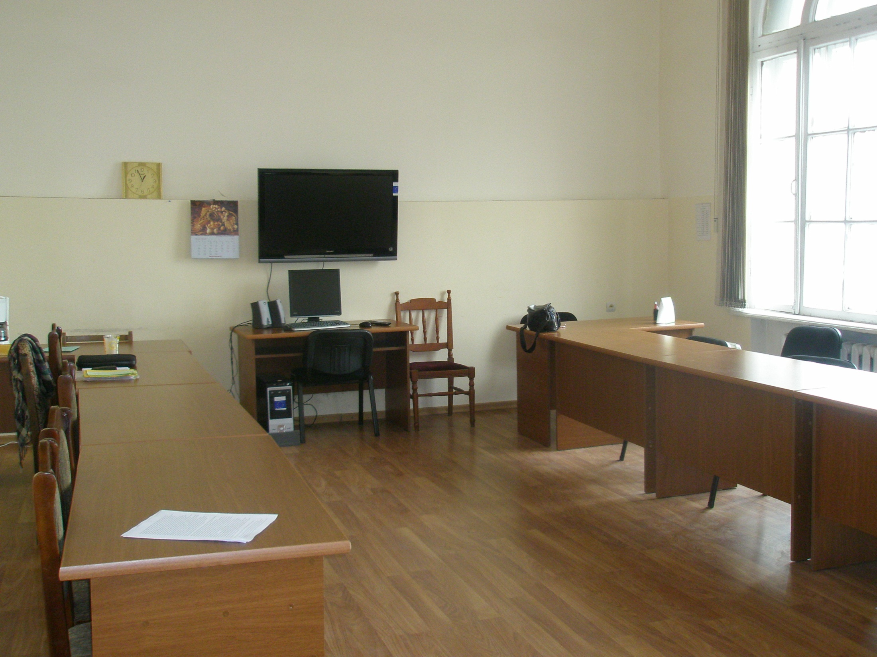
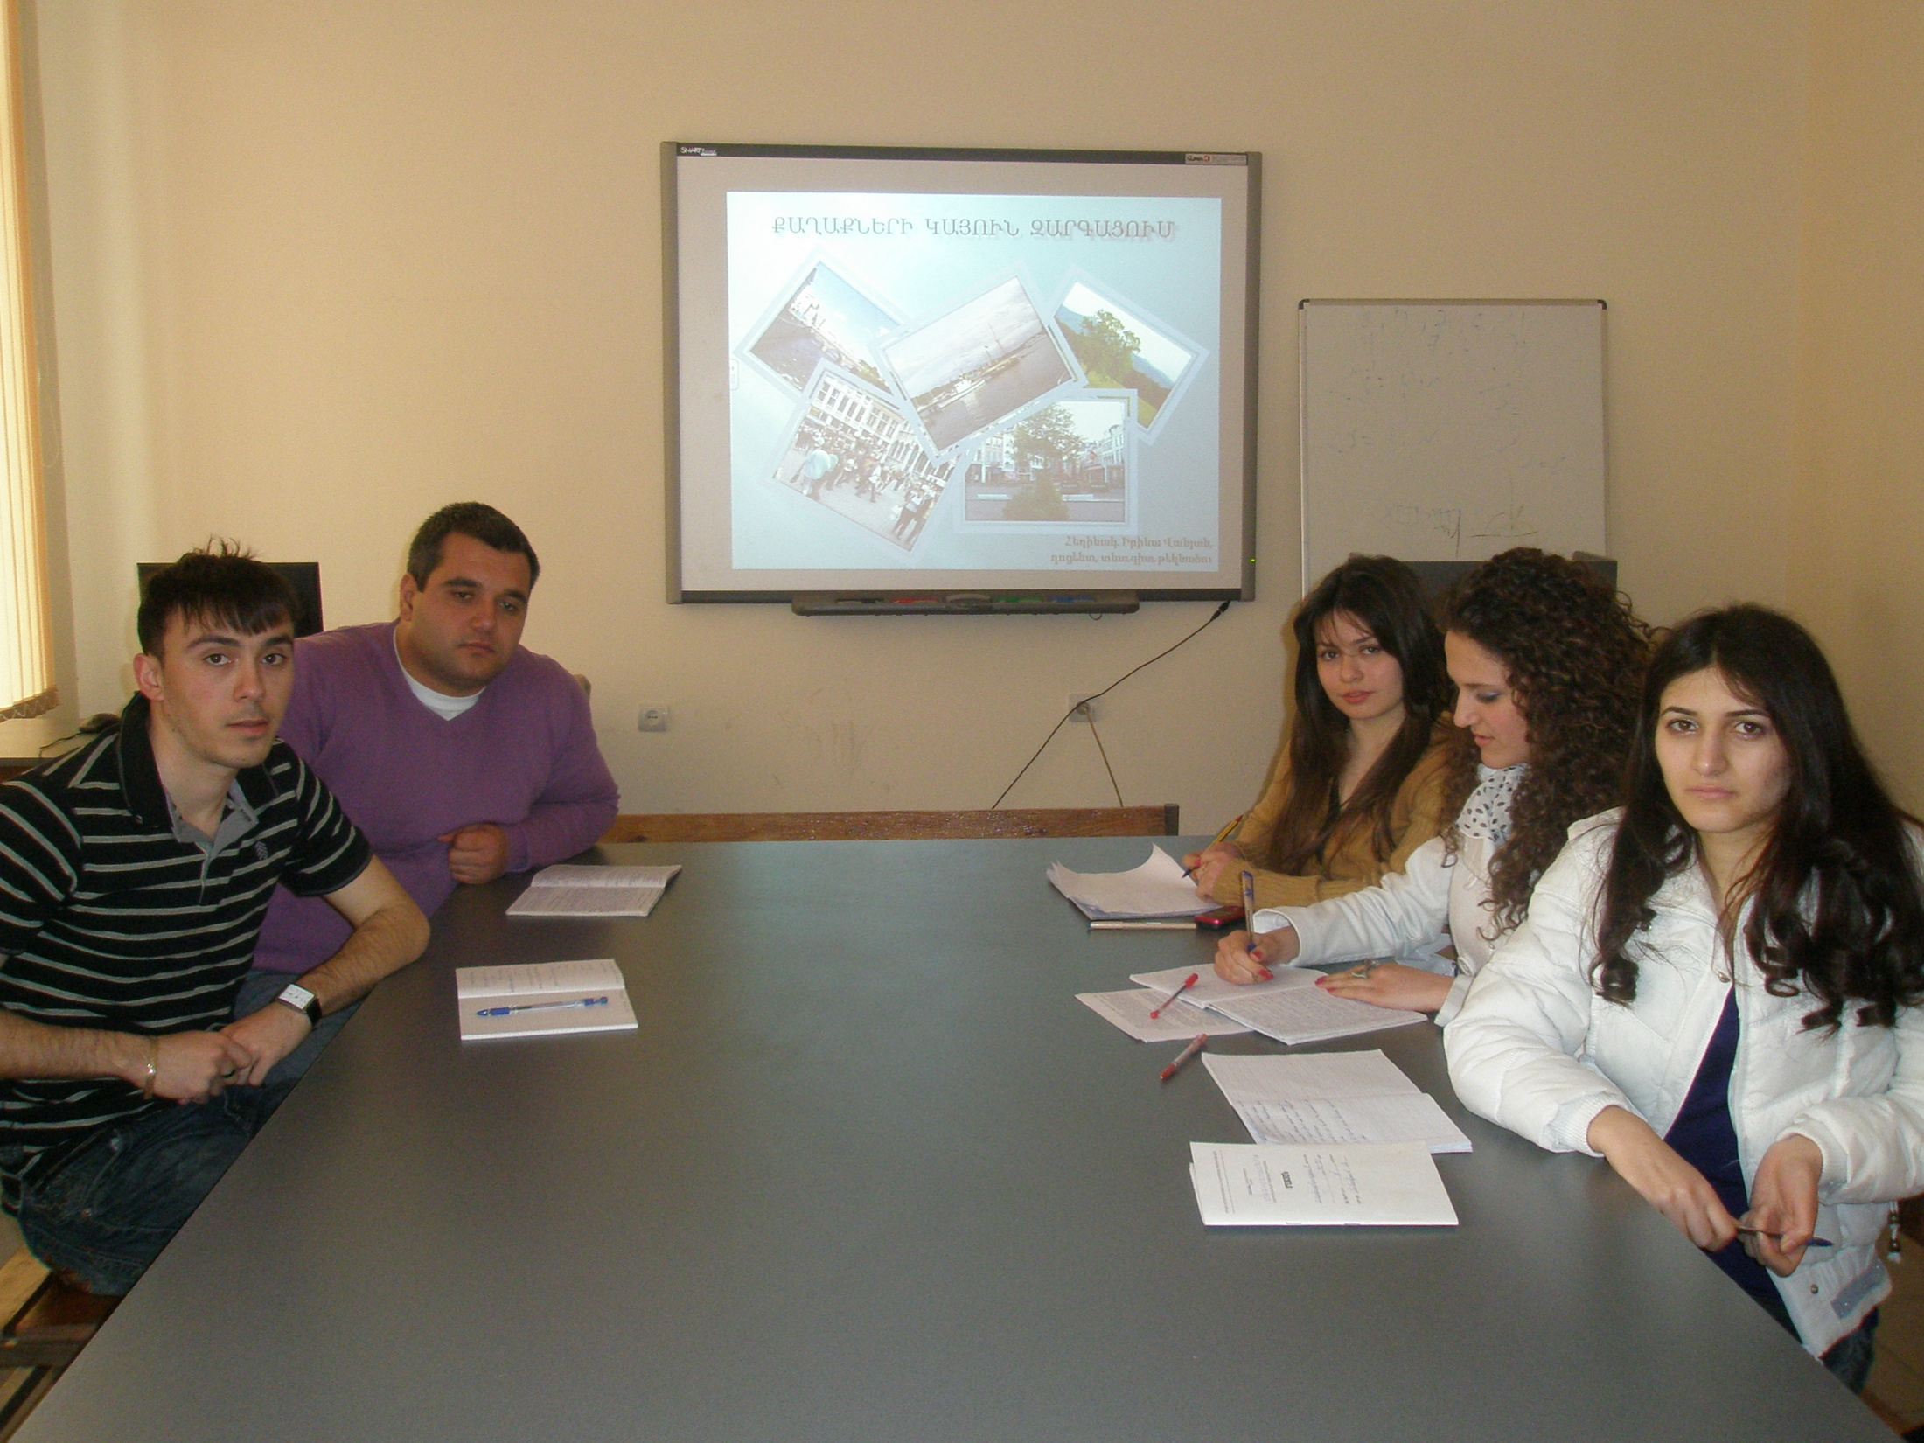
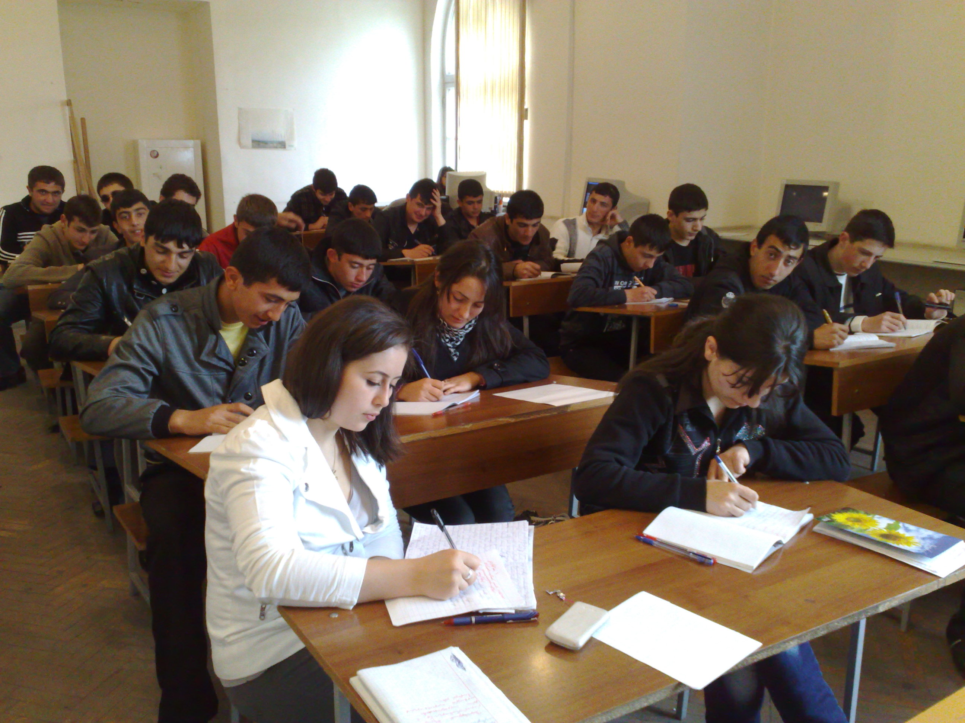
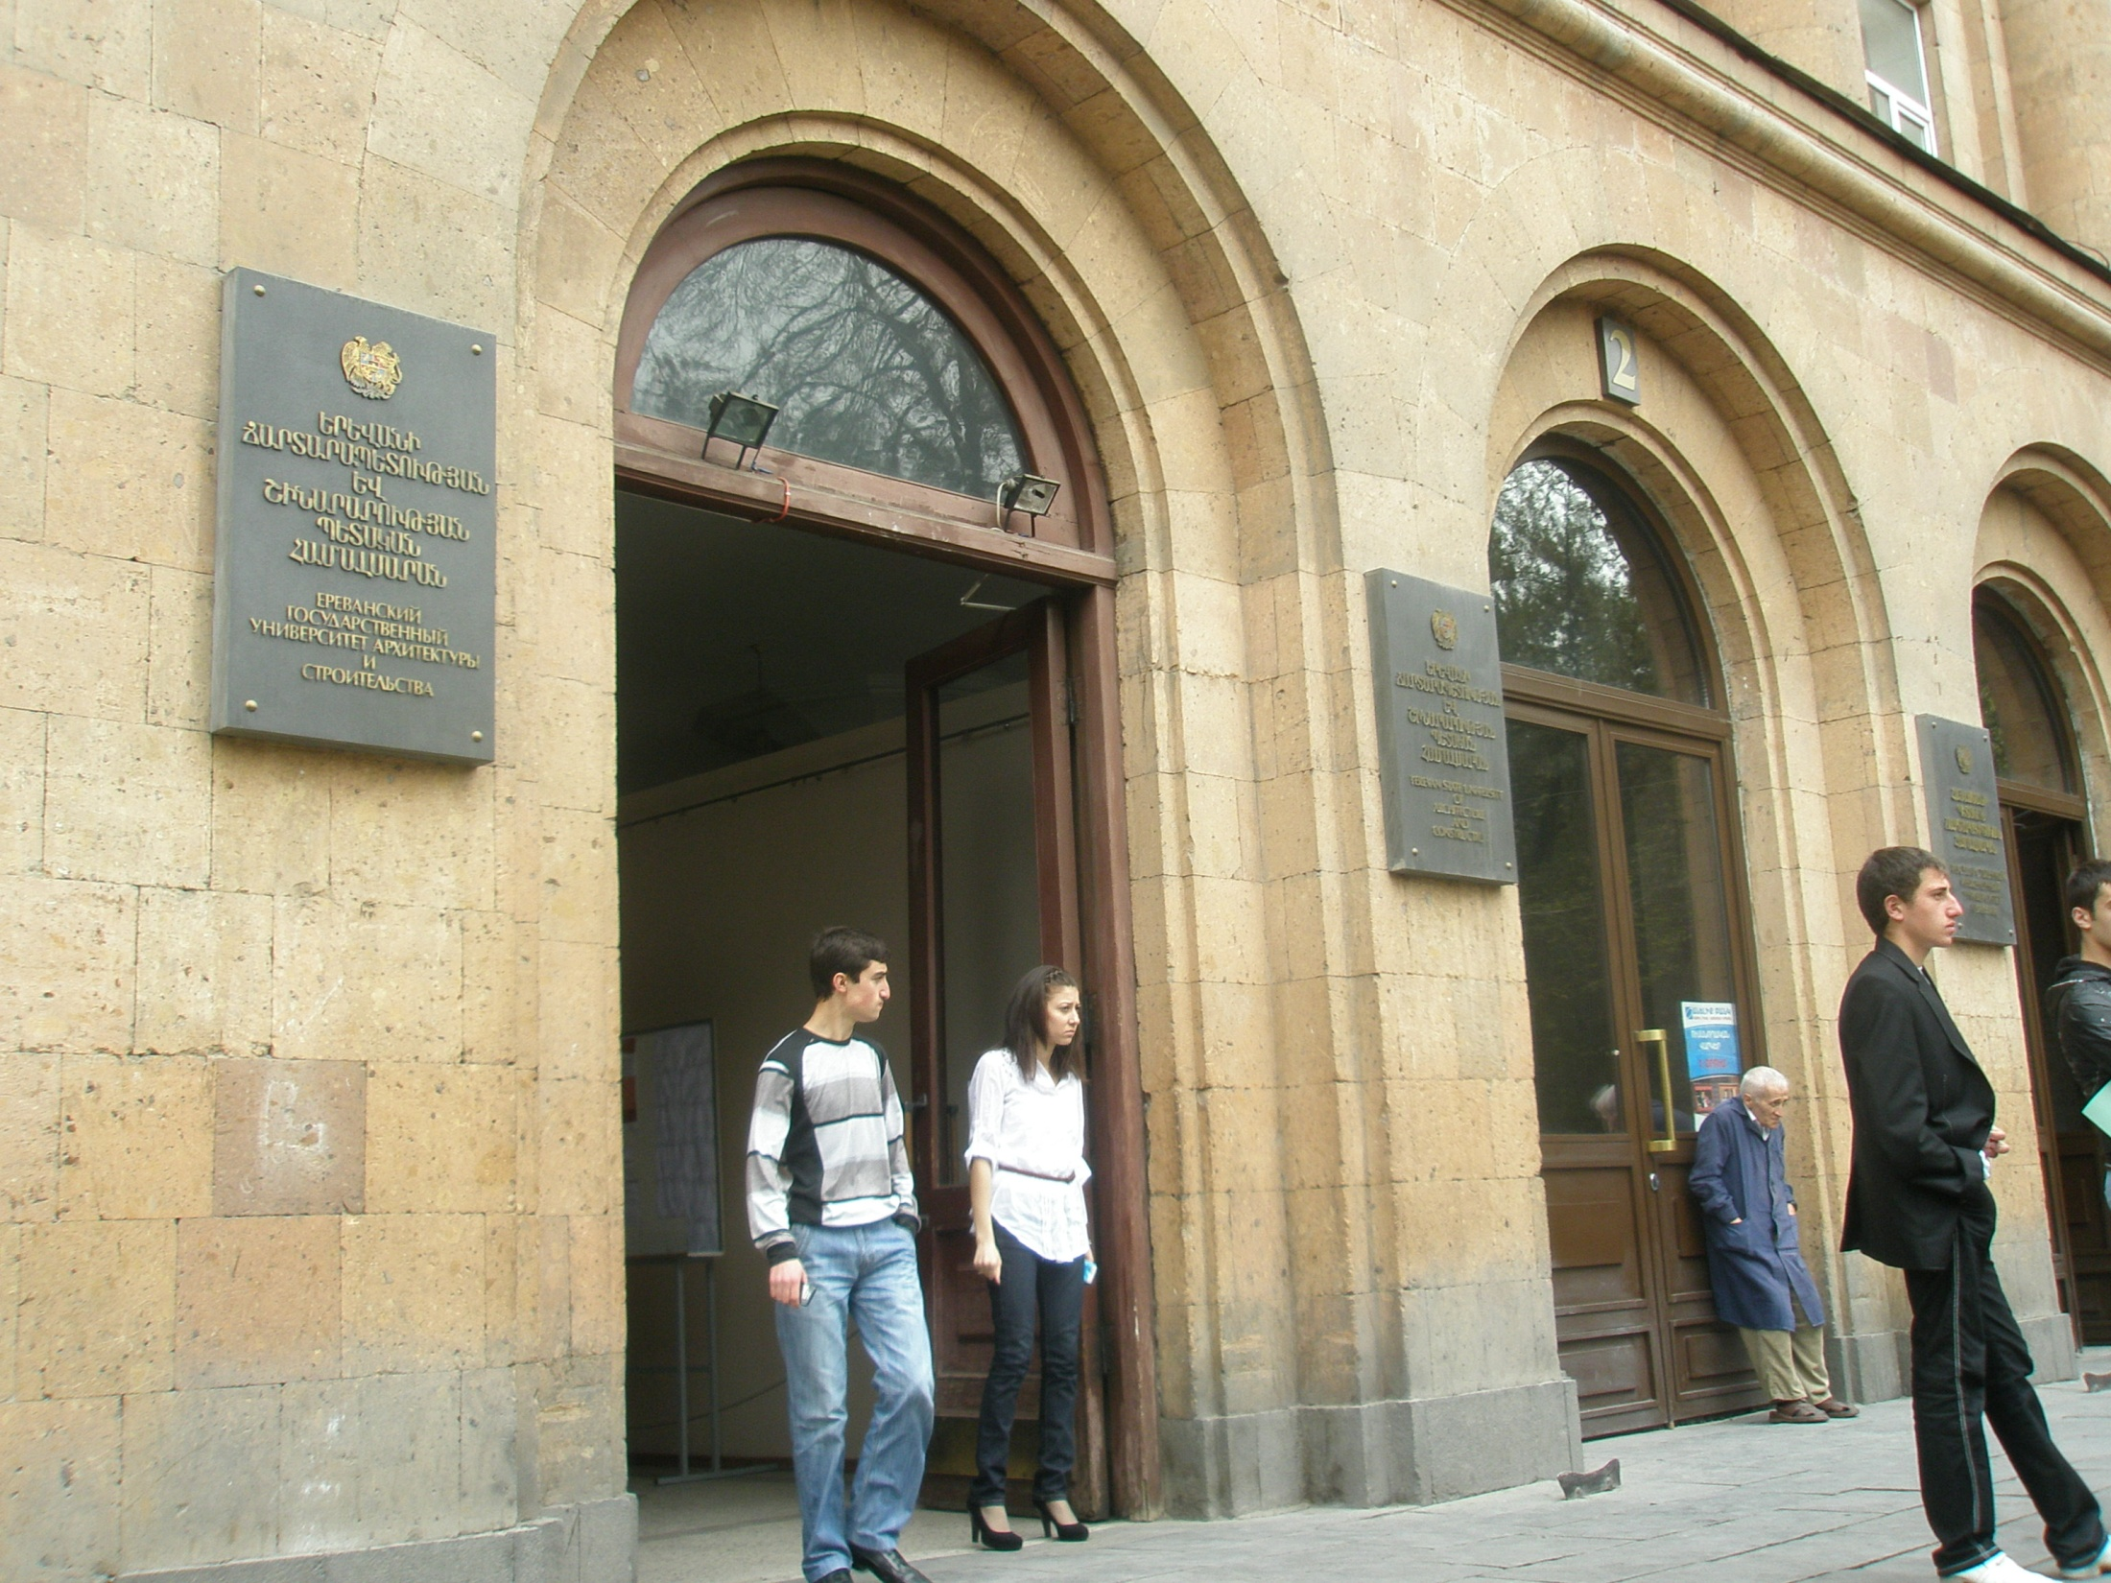
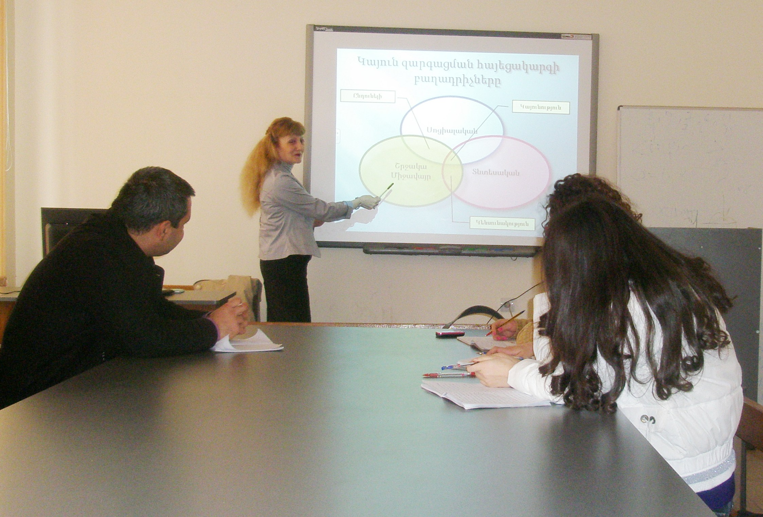
YEREVAN STATE UNIVERSITY OF ARCHITECTURE AND CONSTRUCTION

Slide 17

YEREVAN STATE UNIVERSITY OF ARCHITECTURE AND CONSTRUCTION
www.ecoma.am
THANK YOU

